Slide 1
CS 4974 Independent Study
10/17/22 meeting
Student: Bug Lee

Slide 2
Last time, we discussed…
VM demo
Running programs written in custom assembly
Suggestion on how to implement pass by reference

Slide 3
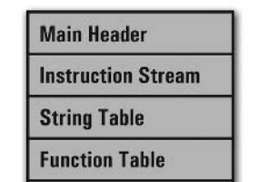
Week 7
Week 7
compiler
assembler
script.source
script.assembly
script.executable
Virtual Machine
CPU

Slide 4
Pass by reference

Slide 5
New instructions
Ref Destination, Source
Store memory address of the Source to Destination.
Lw Destination, Address, Offset
Load value at memory location [Address + Offset] to Destination.
Sw Address, Offset, Source
Store Source value to memory location [Address + Offset].

Slide 6
Preprocessor

Slide 7
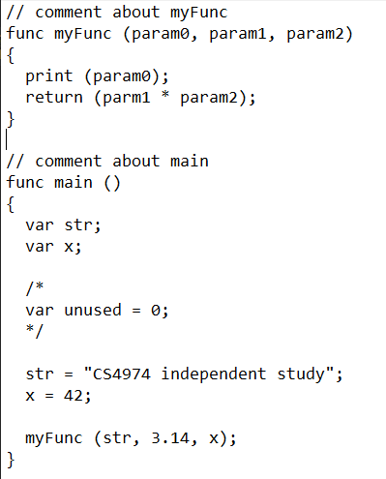
Preprocessor

Slide 8
Preprocessor (future plan)
Importing file
Support for basic macro

Slide 9
Compiler lexer

Slide 10
Compiler lexer
A lot of design aspects were reused from the assembly lexer
Regular expression and State machine
A lot more reserved word, delimitors, and token types.

Slide 11
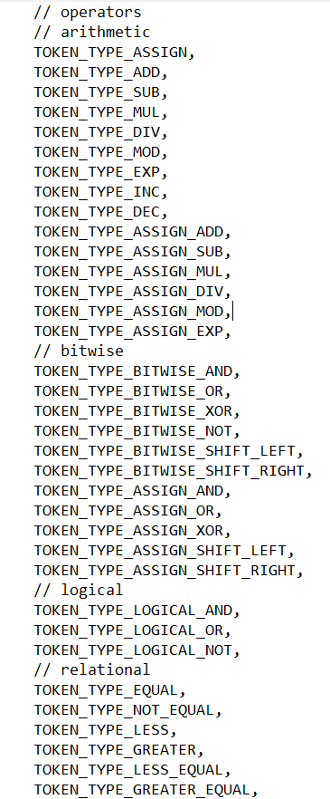
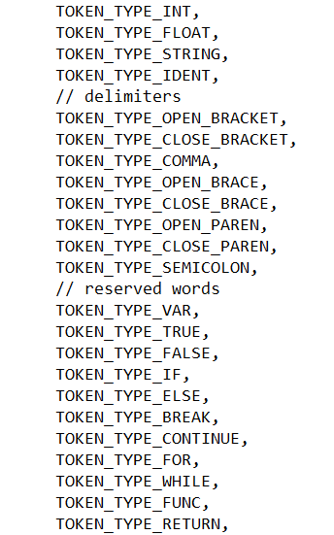

Slide 12
Lexer demo

Slide 13
Plan for week 8
Start Compiler parser/code generator implementation.
Empty statement
Function declaration
Function body (block)
Variable and array declarations
Basic expression

